Slide 1
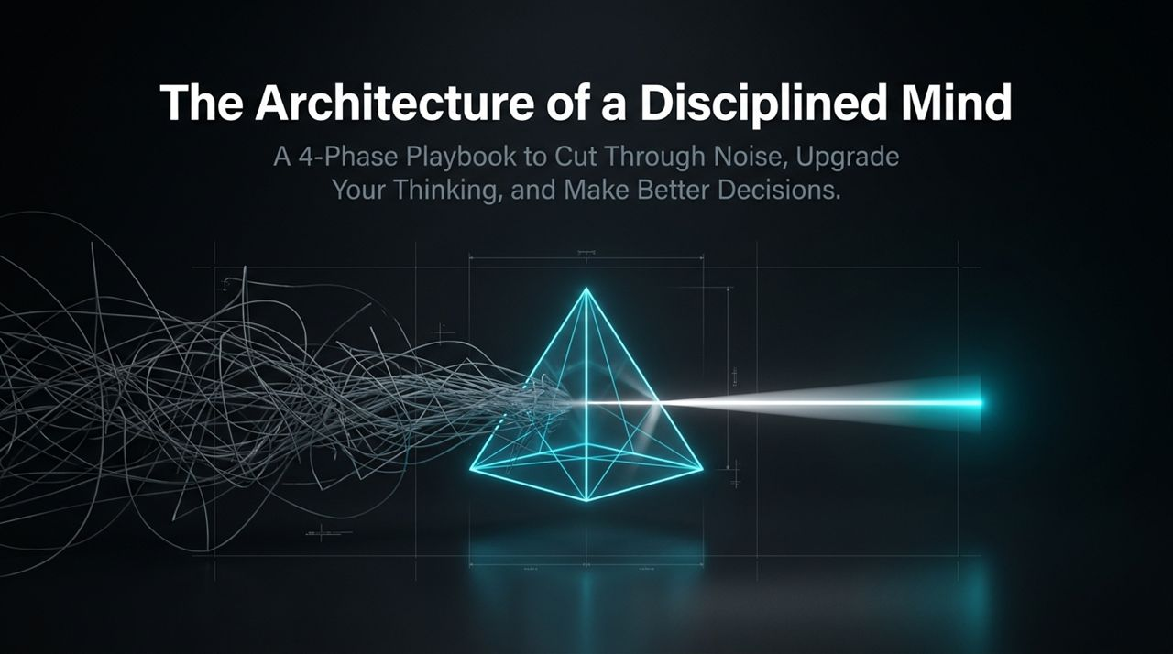
Notes:
Welcome, everyone. Look at the image on this title slide. On the left side, you see a tangle of wires—chaos, mental noise, and reactive habits. On the right, through a prism, that chaos is funneled into a single, sharp, concentrated beam of light.
That is the premise of today’s session: The Architecture of a Disciplined Mind. We are living in an era where we are constantly inundated with information, opinions, outrage, and notifications. Most people do not suffer from a lack of intelligence; they suffer from an overload of uncurated input and an unexamined mental operating system.
Over the course of this presentation, we will walk through a 4-phase playbook designed to help you cut through the noise, upgrade your internal processing, and make better decisions under pressure. Critical thinking is not something you are simply born with; it is an active discipline and a trainable architecture. Today, we lay down the blueprint.
Improving Your Critical Thinking Skills | Think Smarter & Make Better Decisions (Audiobook)
https://www.youtube.com/watch?v=vKPvsr64U2w

Slide 2
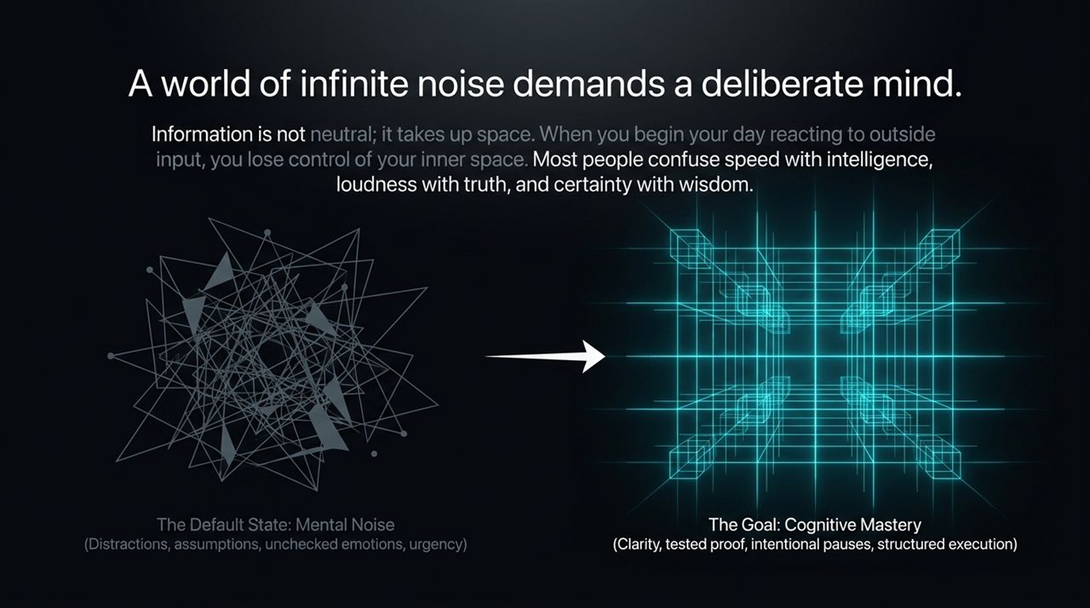
Notes:
Let’s start with a truth we often overlook: Information is not neutral; it takes up real estate in your mind. Every email, headline, and unsolicited opinion you consume in the morning occupies cognitive bandwidth. When you begin your day reacting to outside input, you surrender control of your inner space.
Most people operate in what we call The Default State: Mental Noise. This default state is driven by distraction, unexamined assumptions, unchecked emotional reactions, and a constant sense of artificial urgency. Society conditions us to confuse speed with intelligence, loudness with truth, and certainty with wisdom.
Our goal throughout this playbook is Cognitive Mastery—shifting from automatic, reactive responses to intentional clarity, tested proof, deliberate pauses, and structured execution.
Notice the Operating System Diagnostic on screen:
The Reactive Mind rushes to judge, fears disagreement, accepts hype, and becomes paralyzed by complexity.
The Disciplined Mind creates space between stimulus and response, uses disagreement to spot blind spots, demands proof, and breaks complexity down. Ask yourself today: Which operating system ran your morning?

Slide 3
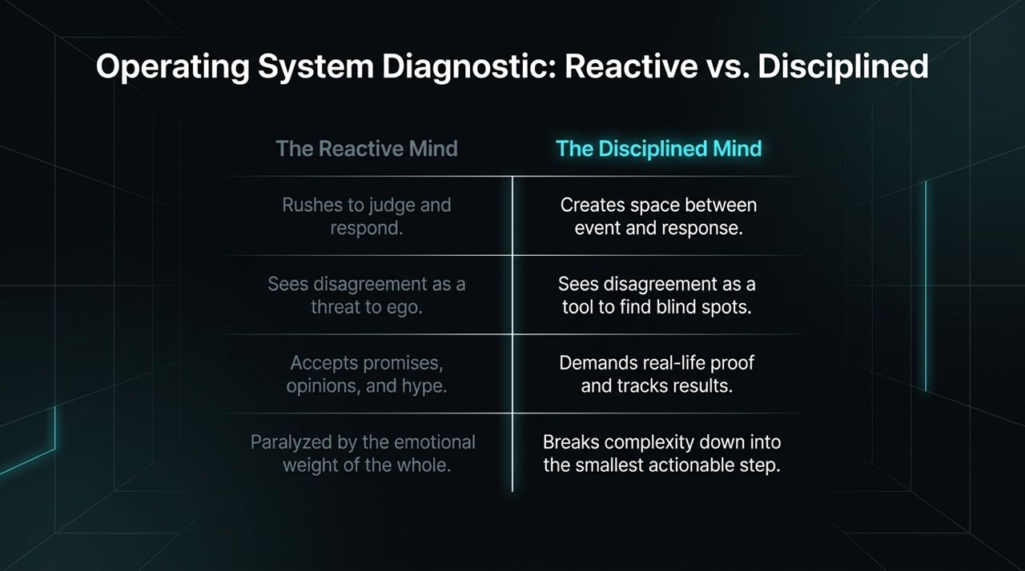
Notes:
To build a disciplined mind, we must recognize that critical thinking is not an innate personality trait—it is a sequential engine. Just like building muscle, you train it through repeated, deliberate practice.
This engine consists of four interconnected pillars:
Input (The Shield): Regulating what enters your mind. Filtering out noise, demanding evidence, and diversifying your sources.
Process (The Filter): Calibrating how you digest information. Slowing down, seeking intellectual friction, and questioning authority with logic.
Execute (The Engine): Moving from thought to action. Deconstructing complex problems and measuring risks deliberately.
Reflect (The Mirror): Continuous alignment through journaling, habit audits, and asking better daily questions.
If any one of these pillars breaks, the entire decision-making process degrades. Over the next slides, we will break down each phase in detail.

Slide 4
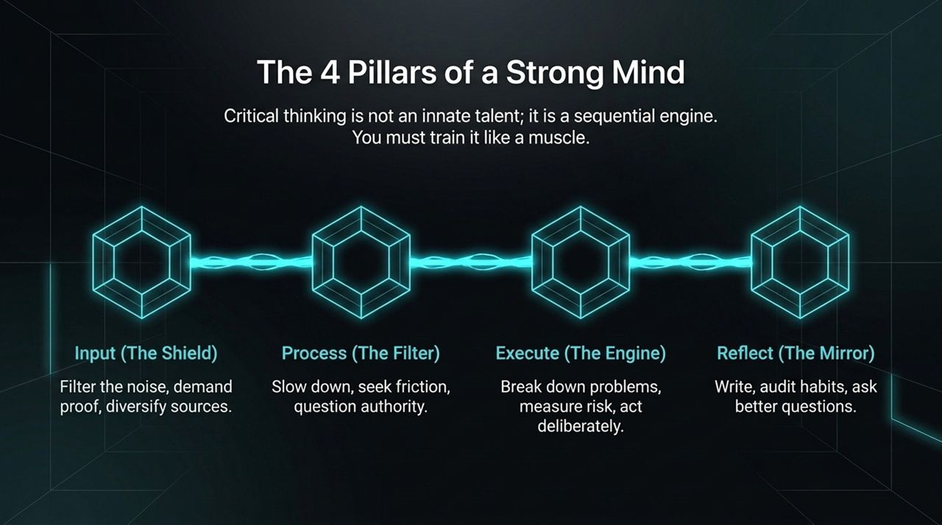
Notes:
Phase 1 begins with Regulating Input. In a world filled with endless hype, an idea only has true value if it holds up in reality. Sounding convincing or eloquent does not make something true.
Look at the funnel diagram on the slide: At the top, you have promises, opinions, hype, and social noise. Most people digest this raw. A disciplined mind passes it through logic, observation, and small-scale testing. The only currency a disciplined mind accepts as final truth is Real-Life Proof.
Furthermore, we must actively combat confirmation bias. Relying on a single source or familiar environment makes you see only what you want to see. To find real truth, you must triangulate:
Gather your Familiar Sources.
Cross-examine them with Historical & Data Context.
Force yourself to look at Opposing Viewpoints.
Truth is rarely found on the extreme ends; it lives in the nuances where perspectives collide.

Slide 5
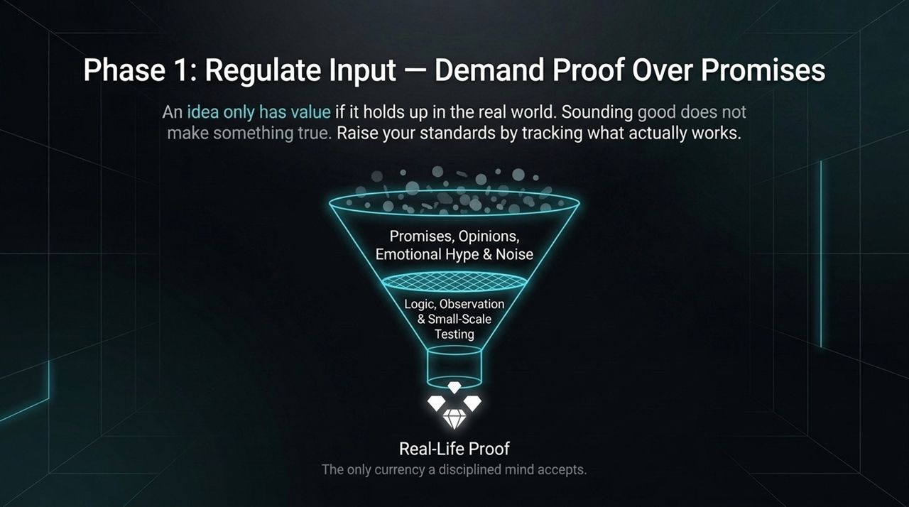
Notes:
Once information passes through your input shield, how do you process it? Phase 2 is about Calibrating Your Processing.
First, you must Embrace Intellectual Friction. Comfortable thinking clings to what feels right. Growth looks deeper to discover what is right. When you encounter an idea that contradicts your worldview, you have three paths:
Blind Obedience: Shutting out contradiction to protect comfort.
Cynical Rebellion: Disagreeing automatically just to be contrarian.
Logical Inquiry: Sitting with an uncomfortable idea to understand it fully before judging it. Discomfort is not a sign of danger; it is a signal of growth.
Second, adopt The Deliberate Pause. The human brain is built for speed and wants to resolve cognitive tension instantly. But urgency is often a trap. When triggered by an event or disagreement, insert a pause:
Let the emotional dust settle.
Gather missing context.
Align your response with values rather than temporary impulses.

Slide 6
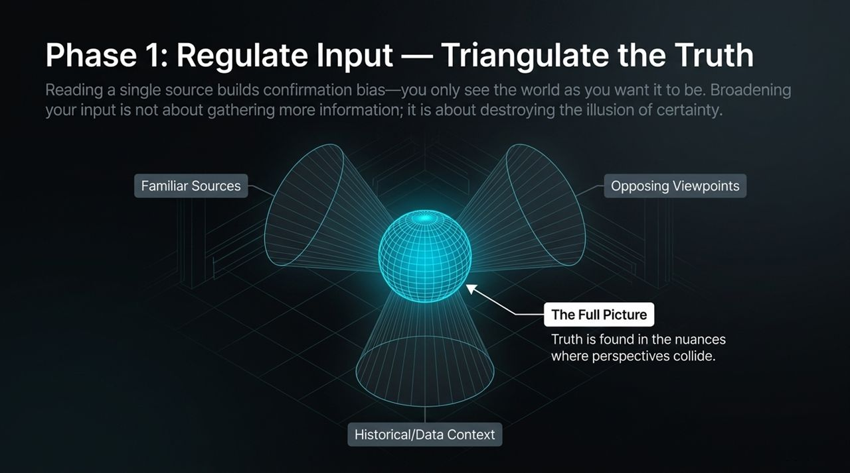
Notes:
Continuing with Phase 2, let’s talk about authority. Respecting leadership or expertise does not mean surrendering your ability to think independently. Real expertise is backed by clear reasoning; power without reason is just force.
When hierarchical pressure or artificial urgency is placed upon you, detach from the emotional stress and weigh the underlying evidence.
Pay attention to the callout on this slide: Instead of reacting combatively by saying 'I won't do this,' pivot to constructive logical inquiry: 'Can you explain the reasoning behind this?'
This single shift changes the dynamic entirely. It moves the conversation away from ego and authority power plays and grounds it in logical consistency and evidence.

Slide 7
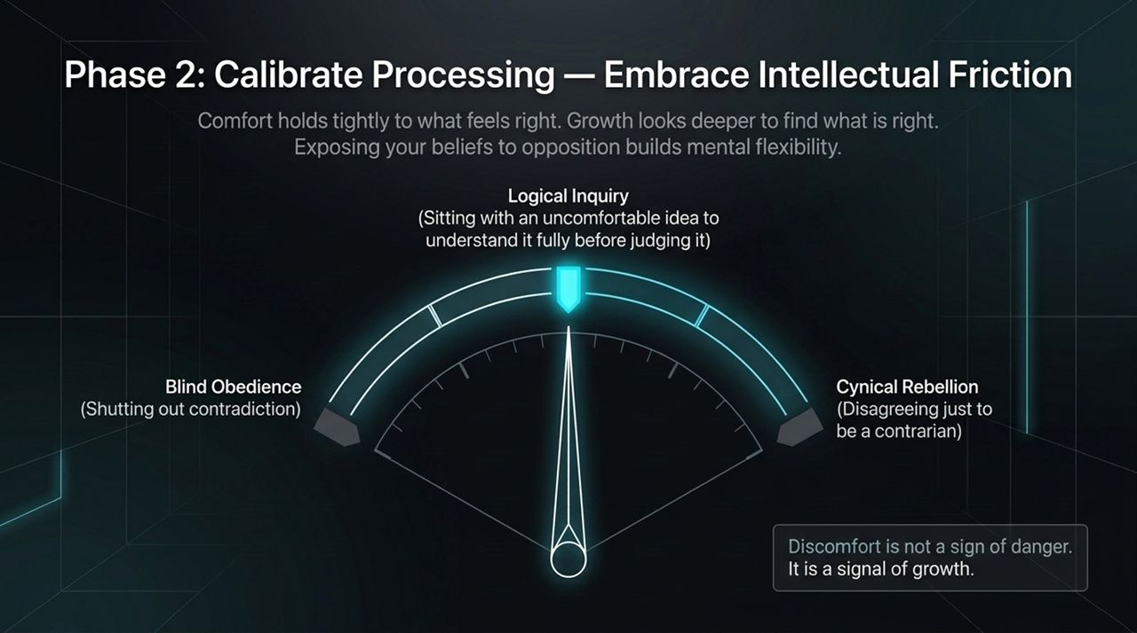
Notes:
Now we transition into Phase 3: Execute Intentionally. You can have great inputs and clear processing, but if you do not translate them into action, you remain stuck.
Most complex problems feel overwhelming because they live in our heads as one massive, tangled block wrapped in fear and anxiety. When a task feels too big, the brain’s default response is avoidance or procrastination.
Clarity comes from motion, not from waiting around for motivation. To execute intentionally, you must deconstruct the complexity:
Identify the single smallest possible forward movement.
Specificity drastically reduces fear.
Don't focus on solving the entire 10-step problem today. Focus on defining and completing Step 1 with absolute precision.

Slide 8
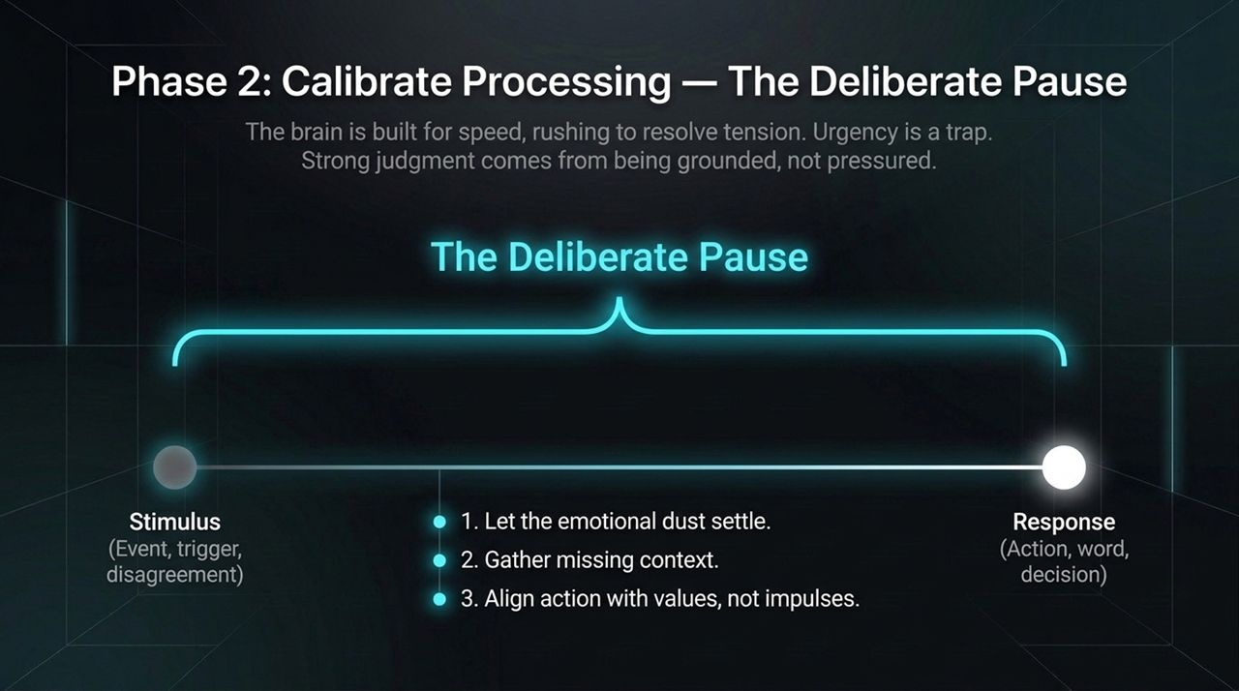
Notes:
Execution requires discipline, and discipline is simply the quiet force that sits between impulse and action. It is the freedom to choose what serves your long-term vision over fleeting gratification.
When faced with a critical choice, stop yourself from acting on immediate impulse. Run your situation through these 3 Questions:
What are my real options? (Look beyond the binary 'either/or' illusion).
What are the long-term consequences of each option? (Second- and third-order thinking).
Which choice aligns with what matters most?
By filtering impulses through these questions, you bridge the gap between initial impulse and Aligned Action.

Slide 9
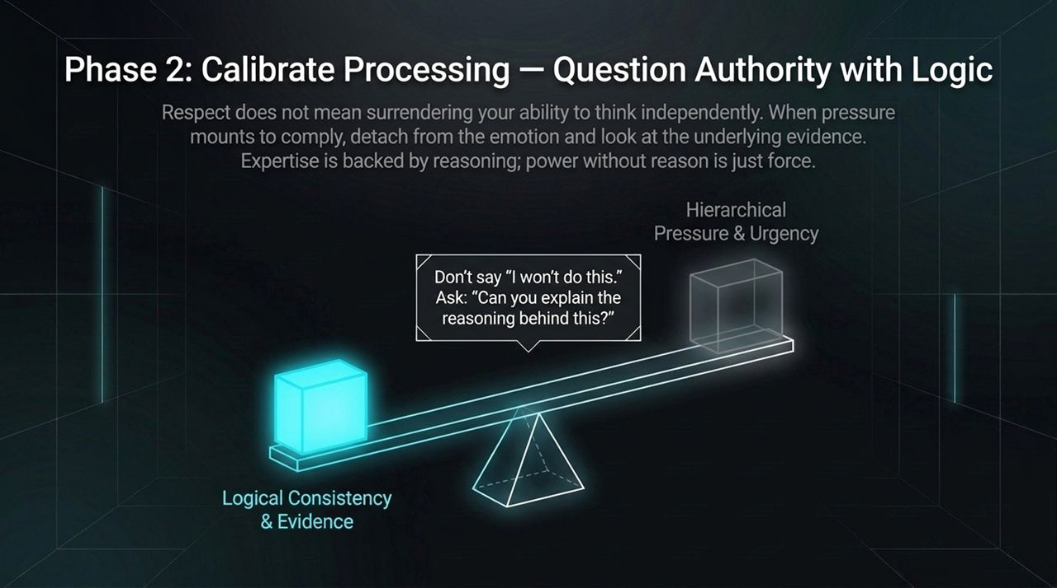
Notes:
We move to Phase 4: Continuous Alignment. A disciplined mind requires ongoing maintenance. You cannot think clearly when your head is full of mental noise.
Writing brings structure to confusion; it makes the invisible visible. When thoughts stay inside your head, they overlap, loop endlessly, and trigger unnecessary anxiety. But when you put those thoughts onto paper, they stand alone. Paper strips away emotional exaggeration and exposes hidden biases and truths.
Establish a Daily Mental Audit. Spend 5 to 10 minutes journaling at the start or end of your day. Externalizing your internal chaos transforms vague, overwhelming emotions into clear, manageable data points.

Slide 10
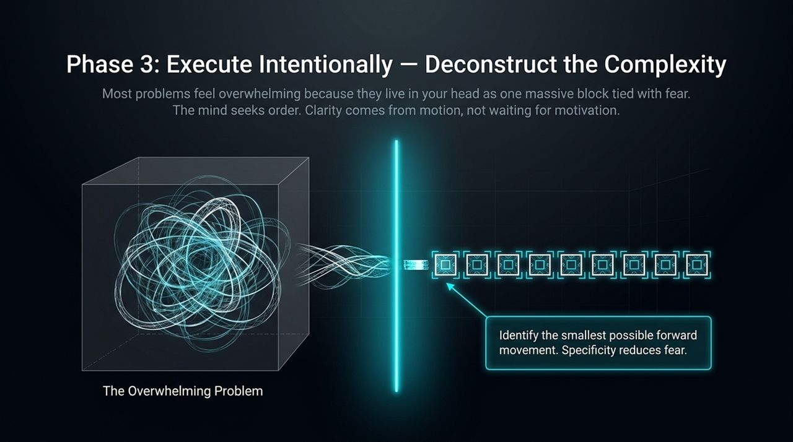
Notes:
Behind every internal thought is an underlying question. The quality of your questions dictates the quality of your life.
Weak, reactive thinking relies on Victimhood Questions:
'Why does this always happen to me?'
'Why are they being so difficult?'
These questions trap you in blame and helplessness. Strong thinkers ask Leadership Questions:
'What is this moment teaching me right now?'
'What is the next right step?'
Notice how leadership questions immediately shift your brain from emotional defensiveness to active problem-solving. You cannot control every external event, but you have total ownership over the questions you ask.

Slide 11
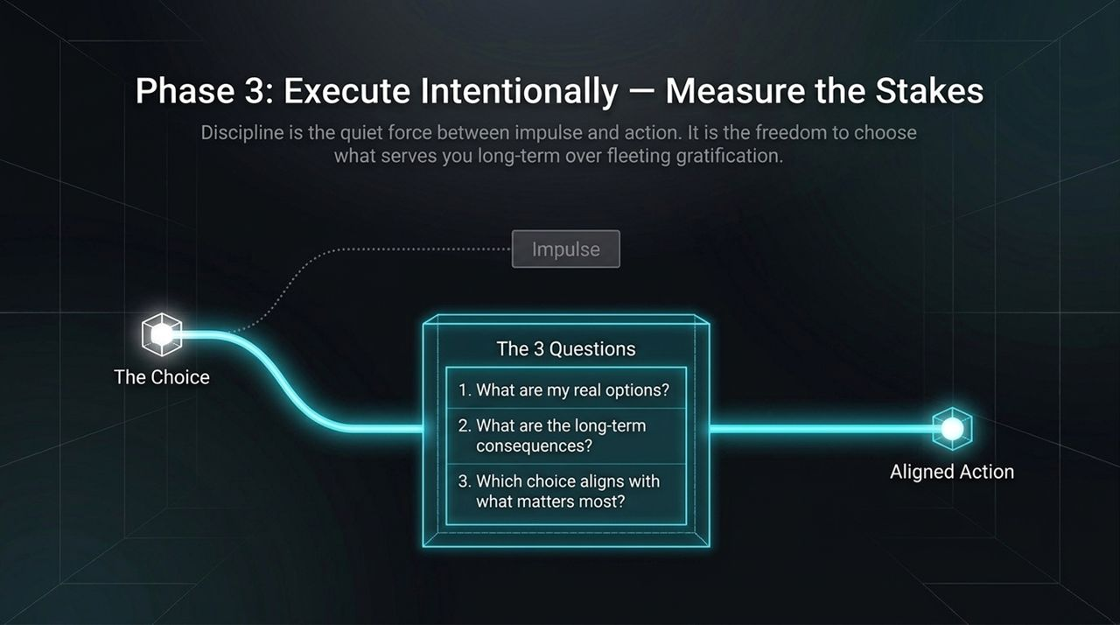
Notes:
Thoughts are not random, unstoppable events; they are seeds planted by where you choose to place your attention.
Look at the ecosystem model on this slide:
The Roots: Mindful Observation—weed out negative, repetitive loops.
The Soil: Your Daily Inputs & Experiences—the environments you choose and media you consume.
The Growth: Chosen Thoughts & Intentional Action.
By consciously selecting empowering thoughts every day, you physically rewire your neural pathways. You move away from the misconception that thoughts just 'happen' to you, recognizing that your inner world is yours to shape.

Slide 12
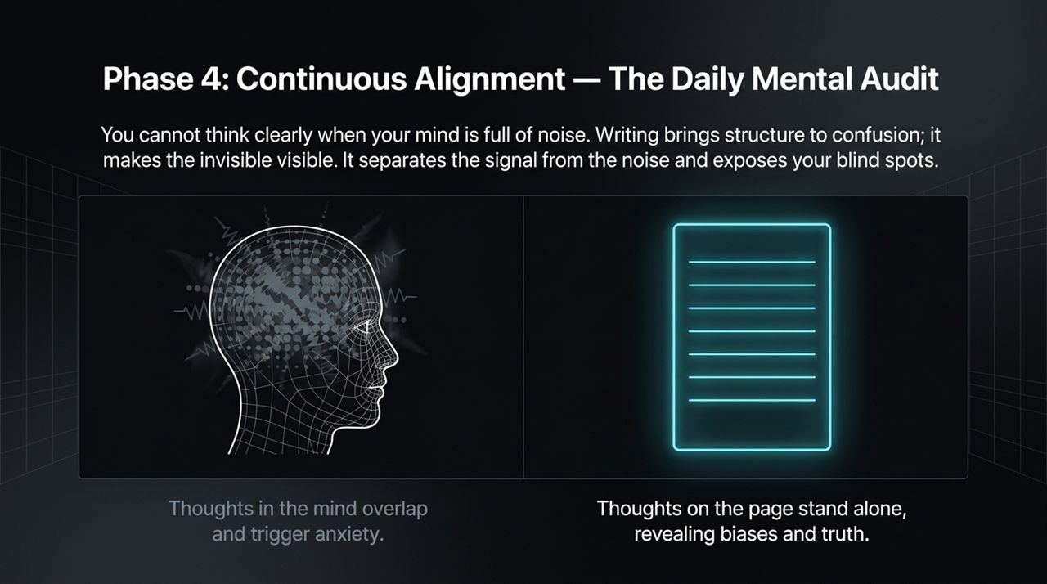
Notes:
None of these habits operate in isolation. They form The Critical Thinking Flywheel:
Regulate & Filter your inputs.
Pause & Challenge your assumptions and processing.
Deconstruct & Act on your decisions.
Audit & Write to reflect and refine.
As you reflect through writing, your inputs become cleaner. As your inputs improve, your processing becomes faster and calmer. As your processing sharpens, your execution becomes more effective. This creates a continuous feedback loop for cognitive growth.

Slide 13
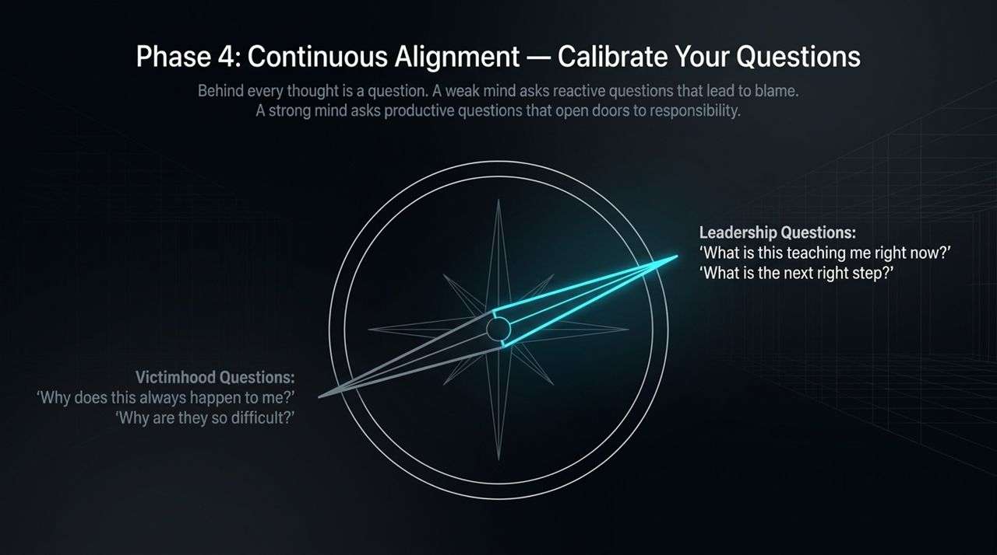
Notes:
This framework summarizes our roadmap into 6 Practical Pillars divided into Foundations and Decision Frameworks:
Foundations of Daily Clarity:
Ask Better Daily Questions: Shift from 'Why me?' to 'What can I learn?'
Remove Mental Noise: Practice single-tasking to eliminate switch-task fatigue.
Writing as a Mirror: Externalize chaos onto paper.
Strategic Decision Frameworks:
4. Slow Down Your Reactions: Protect the space between stimulus and response.
5. Demand Proof Over Promises: Test ideas against real-world data.
6. Measure Risk vs. Reward: Explicitly list potential downside versus upside.
Contrast weak thinking with strong thinking: Weak thinking relies on vague questions, rigid beliefs, and immediate emotional reactions. Strong thinking uses productive questions, tested beliefs, and deliberate pauses.

Slide 14
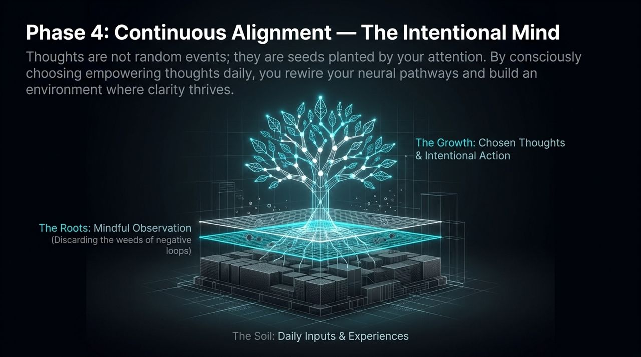
Notes:
Slide 14 gives us The Critical Thinker’s Blueprint. Let's compare passive mental habits with critical mental habits across key areas:
Daily Focus: Passive minds operate in reactive overwhelm; critical minds are intentional and step-based.
Disagreement: Passive minds become defensive and demand certainty; critical minds remain curious, seeking opposite views to disrupt bias.
Failure: Passive minds view failure as proof of personal limits; critical minds treat failure as feedback for iterative improvement.
Ground your daily routine in these four disciplines: Ask learning questions, remove mental noise, externalize thoughts in writing, and leverage the strategic pause.

Slide 15
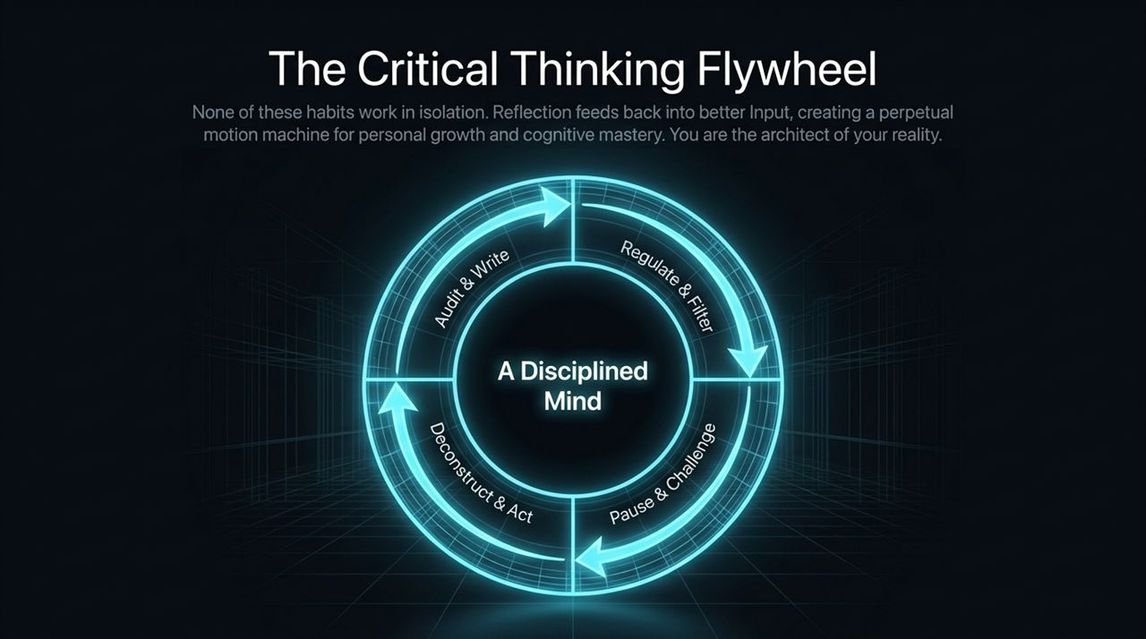
Notes:
Let me share a quick operational checklist you can apply whenever you encounter new information:
Source Audit: Is this coming from an incentive-driven source, or is there objective data behind it?
Falsifiability Check: What evidence would prove this claim wrong? If nothing can prove it wrong, it’s an ideology, not a fact.
The 24-Hour Cooling Period: For high-stakes decisions or emotionally charged news, enforce a mandatory 24-hour pause before taking action.
Protecting your morning hours from digital input preserves your cognitive energy for high-value processing.

Slide 16
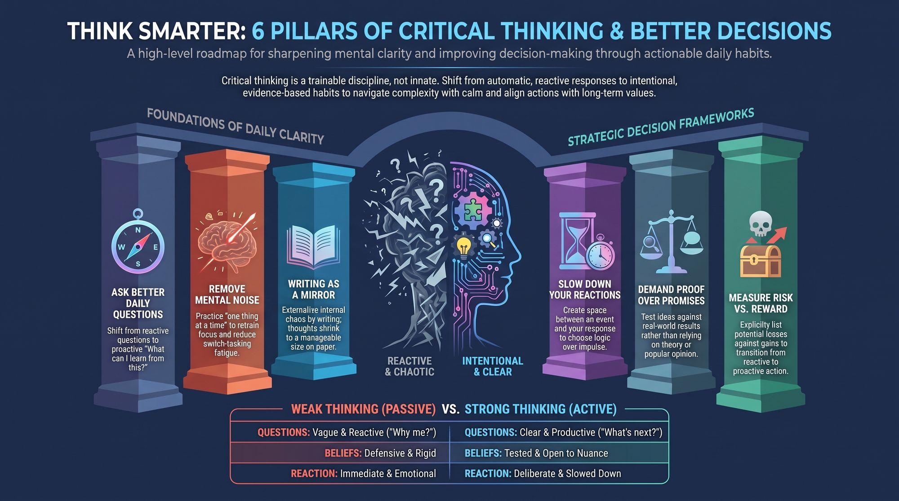
Notes:
To conclude our walk-through of Slides 1 through 16, let’s summarize your daily action plan:
Morning: Protect your inner space. Ask one high-leverage question: 'What is the most important task today?'
Midday: Use the strategic pause. When friction arises, ask: 'Can you explain the reasoning behind this?'
Evening: Audit your mind. Spend 5 minutes writing down lingering thoughts to clear mental clutter.
You are the architect of your own reality. Master your inputs, calibrate your processing, execute with intention, and audit regularly. Thank you.
Improving Your Critical Thinking Skills | Think Smarter & Make Better Decisions (Audiobook)
https://www.youtube.com/watch?v=vKPvsr64U2w

Slide 17
